Slide 1
F. Y. B. Tech. Pattern 2022 Semester: II FYE221011: Programming in C++
Prof. P. D. Rakibe(C)
Prof. S. D. Jadhav (D)

Slide 2
Agenda
Objective & Outcome
Procedural Programming
Object Oriented Programming

Slide 3
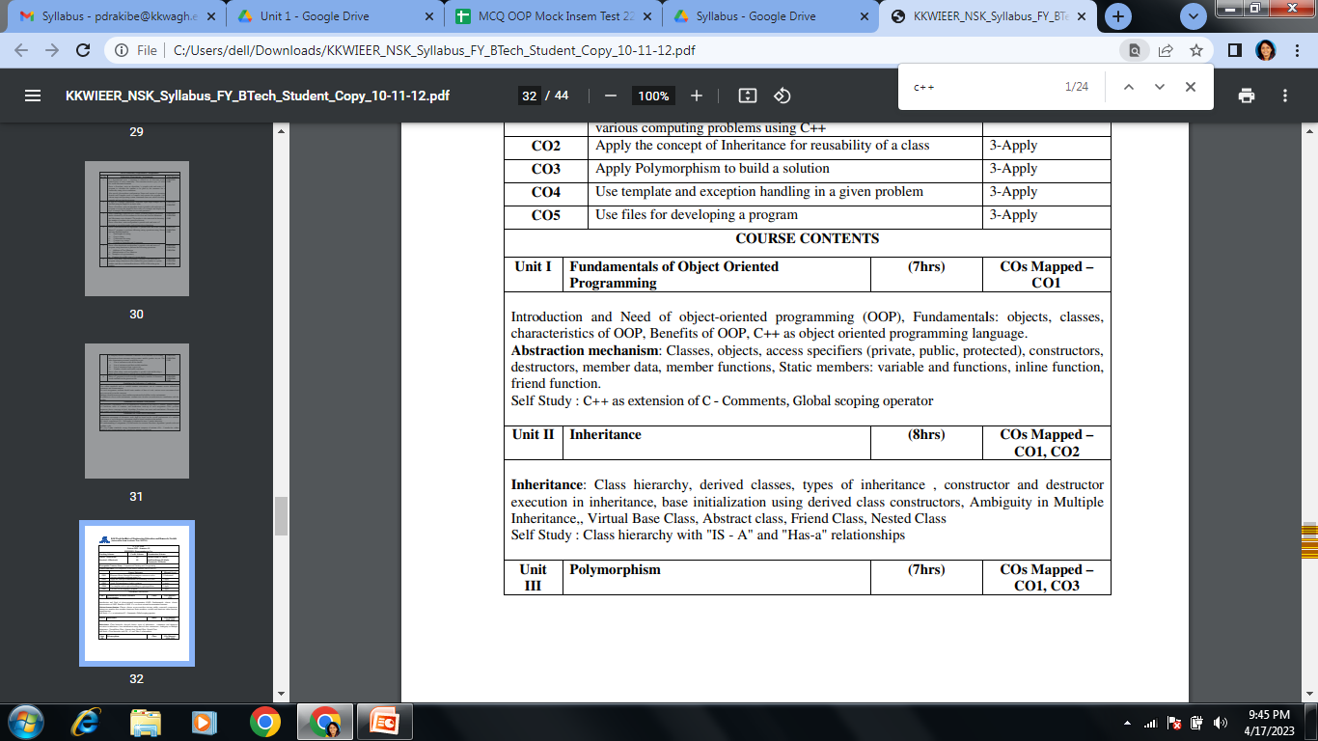
Contd…

Slide 4
Objective & Outcome
Objective
To explore & understand the principles of Object Oriented Programming(OOP)
Outcome
To apply Object Oriented Programming concepts to solve various computing problems

Slide 5
Procedural Programming
Procedural programming is the standard approach used in traditional computer language such as C, Pascal, FORTRAN & BASIC
The design method used in procedural programming is called Top Down Design
Procedural programming creates a step by step program that guides the application through a sequence of instructions. Each instruction is executed in order
Procedural programming focuses on processes. In procedural programming data and functions are stored in separate memory location, while in OOP data and functions are stored in same memory location

Slide 6
Contd…
Programs are made up of modules, which are parts of a program that can be coded and tested separately, and then assembled to form a complete program
In procedural languages (i.e. C) these modules are procedures, where a procedure is a sequence of statements
In C for example, procedures are a sequence of imperative statements, such as assignments, tests, loops and invocations of sub procedures. These procedures are functions, which map arguments to return statements

Slide 7
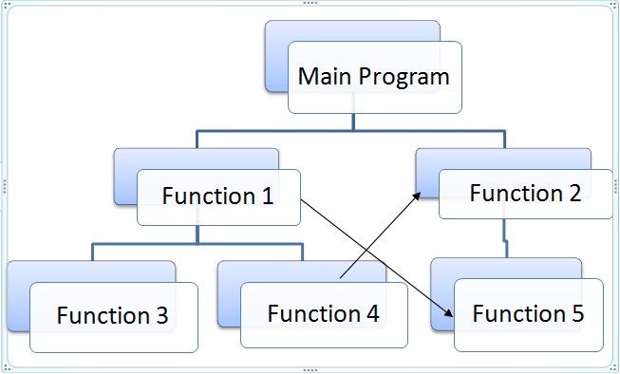
Contd…

Slide 8
Contd…
In C, a data member must be declared GLOBAL inorder to make it accessible by 2 or more functions in the program
What happens when 2 or more functions work on the same data member ? If there are 10 functions in a program, all these 10 functions can access a global data member. It is possible one function may accidentally change values of this global data member

Slide 9
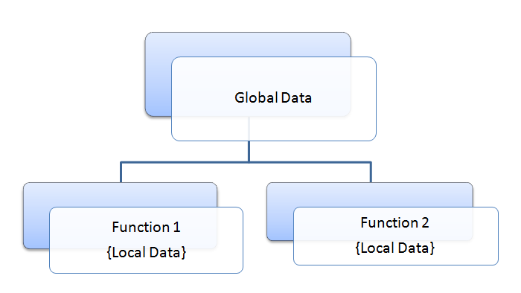
Contd…

Slide 10
Object Oriented Programming
The focus of OOP languages is not on structure, but on modeling data
Programmers code using “blueprints” of data models called classes
Examples of OOP languages include C++, Visual Basic.NET and Java

Slide 11
Contd…
Everything in OOP is grouped as self sustainable “objects”.
In OOP programmers define not only the data type of a data structure, but also the types of operations/methods(functions) that can be applied to the data structure
In this way , the data structure becomes an object that includes both data and functions (methods) in one unit
For example, objects can inherit characteristics from other objects

Slide 12
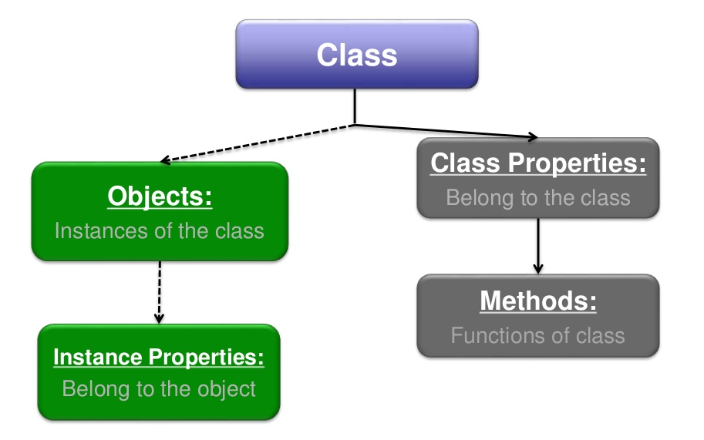
Classes (Objects)

Slide 13
Procedural VS Object Oriented Programming
POP | OOP
In POP, program is divided into small parts called functions | In OOP, program is divided into parts called objects
POP does not have any proper way for hiding data so it is less secure | OOP provides Data Hiding so provides more security
Example : C, VB, FORTRAN | Example : C++, Java, C#.NET

Slide 14
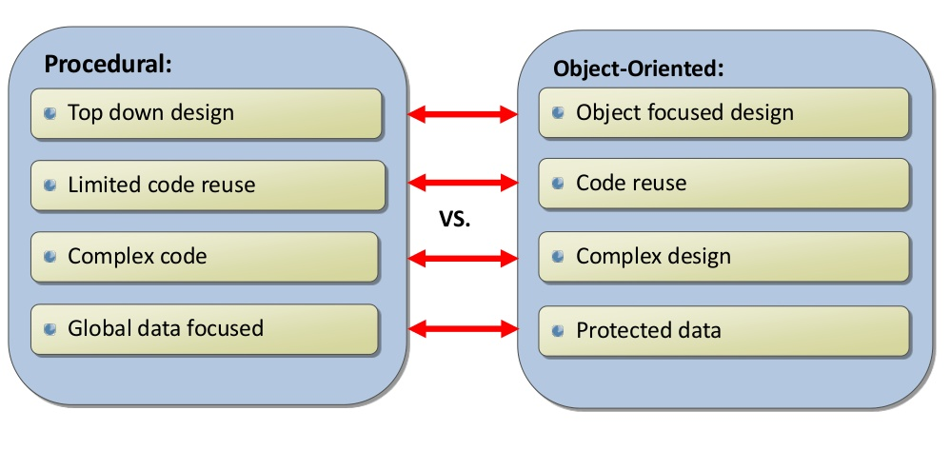
Contd…

Slide 15
Real World Example
Assume that you are working for a vehicle parts manufacturer that needs to update its online inventory system. Your boss tells you to program two similar but separate forms for a website, one form that processes information about cars and one that does the same for trucks
For cars, we will need to record the following information: Color, Engine Size, Transmission Type, Number of Doors
For Trucks, the information will be similar, but slightly different. We need: Color, Engine Size, Transmission Type, Cab Size, Towing Capacity

Slide 16
Scenario
Suppose that we need to add a bus form, that record the following information:
Color, Engine Size, Transmission Type, Number of passengers
Procedural: It recreate the entire form, repeating the code for Color, Engine Size and Transmission Type
OOP: It simply extend the vehicle class with a bus class and add the method, numberOfPassengers

Slide 17
Objective and Outcomes
Objectives
To explore & understand the principles of Object Oriented Programming (OOP).
To use the object-oriented paradigm in program design.
Outcomes
Analyze the strengths of object oriented programming
Apply Object Oriented Programming concepts to solve various computing problems

Slide 18
Contents
Procedural Oriented Programming
Need of Object Oriented Programming
Object Oriented Programming Paradigms
Features of Object Oriented Programming
Benefits of Object oriented Programming
Object Oriented Language
Applications of Object oriented Programming
Introduction of C++
Application of C++

Slide 19
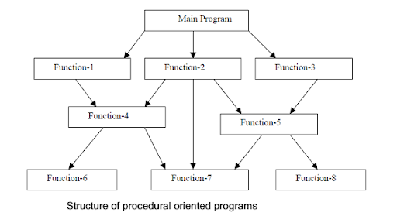
Procedural oriented programming
Problem is solved as a sequence of statements
Input, processing and output
Functions are used to perform the task

Slide 20
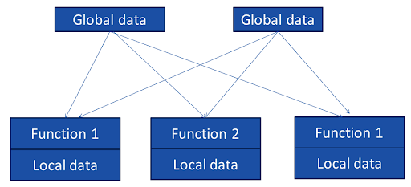
Structure of Procedural Programming
List of instructions are written and organized into groups (functions)
Focus is on functions and not on data
Because of multiple functions, data needs to be global
Relationship of data and function in procedural programming

Slide 21
Characteristics
Emphasis is one performing task
Large problem is divided into smaller sub-problems
Most functions share global data
Data moves openly around the system from function to function
Functions may change data
Follows top down approach in program design

Slide 22
Need of object oriented programming
Overcomes some flaws of Procedural oriented programming
Treats data as critical element
Do not allow data to flow freely around the system
Attach data more closely to the functions which operate on it
Allows to decompose a problem into a number of entities called objects and then builds data and function around these objects

Slide 23
Object Oriented Paradigm
Object A
Object B
Data
Data
Communication
Function
Function
Object C
Data
Function

Slide 24
Features of Object Oriented Programming
Emphasis is on data rather than procedure.
Programs are divided into what are known as objects.
Data structures are designed such that they characterize the objects.
Functions that operate on the data of an object are ties together in the data structure.
Data is hidden and cannot be accessed by external function.
Objects may communicate with each other through function.
New data and functions can be easily added whenever necessary.
Follows bottom up approach in program design.

Slide 25
Benefits of Object oriented Programming
Through inheritance, we can eliminate redundant code extend the use of existing Classes.
We can build programs from the standard working modules that communicate with one another, rather than having to start writing the code from scratch
The principle of data hiding helps the programmer to build secure program that can not be invaded by code in other parts of a programs.
It is possible to have multiple instances of an object to co-exist without any interference.
It is possible to map object in the problem domain to those in the program.
It is easy to partition the work in a project based on objects.
The data-centered design approach enables us to capture more detail of a model can implemental form.
Object-oriented system can be easily upgraded from small to large system.
Message passing techniques for communication between objects makes to interface descriptions with external systems much simpler.
Software complexity can be easily managed.

Slide 26
Object Oriented Language
Depending upon the features they support, they can be classified into the following two categories
Object-based programming languages
Object-oriented programming languages.

Slide 27
Object-based programming
It is the style of programming that primarily supports encapsulation and object identity.
Major feature that are required for object based programming are
Data encapsulation
Data hiding and access mechanisms
Automatic initialization and clear-up of objects
Operator overloading
Languages that support programming with objects are said to the objects-based programming languages. They do not support inheritance and dynamic binding. Ada is a typical object-based programming language.

Slide 28
Object-oriented programming language
It incorporates all of object-based programming features along with two additional features, namely, inheritance and dynamic binding
Object-oriented programming can therefore be characterized by the following statements:
Object-based features + inheritance + dynamic binding

Slide 29
Applications
Simulation and modelling
Real-time system
Object-oriented databases
Hypertext, Hypermedia, and expertext
AI and expert systems
Neural networks and parallel programming
Decision support and office automation systems
CIM/CAM/CAD systems

Slide 30
Introduction of C++
C++ is an object-oriented programming language
It was developed by Bjarne Stroustrup at AT&T Bell Laboratories in Murray Hill, New Jersey, USA, in the early 1980’s.
C++ is an extension of C with a major addition of the class
Stroustrup initially called the new language ‘C with classes’. However, later in 1983, the name was changed to C++.
The idea of C++ comes from the C increment operator ++
C+ + is a superset of C. Almost all c programs are also C++ programs.
The most important facilities that C++ adds on to C care classes, inheritance, function overloading and operator overloading. These features enable creating of abstract data types, inherit properties from existing data types and support polymorphism, thereby making C++ a truly object-oriented language.

Slide 31

Object Oriented Programming
Properties
Make
Model
Color
year
Price
Events
On_Start
On-Drive
On_Brake
Methods
Start
Drive
Park

Slide 32
Application of C++
C++ is a versatile language for handling very large programs; it is suitable for virtually any programming task including development of editors, compilers, databases, communication systems and any complex real life applications systems.
C++ allow us to create hierarchy related objects
While C++ is able to map the real-world problem properly
C++ programs are easily maintainable and expandable. When a new feature needs to be implemented, it is very easy to add to the existing structure of an object
It is expected that C++ will replace C as a general-purpose language in the near future

Slide 33
Reference
E Balagurusamy Object-Oriented Programming with C++.7thedition.McGraw-Hill Publication, ISBN 10: 9352607996 ISBN 13: 9789352607990

Slide 34
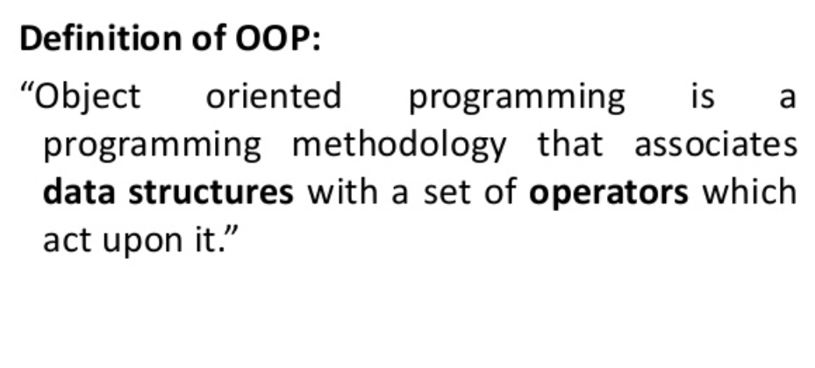
Basic Concept

Slide 35
Elements of OOP
Objects
Classes
Encapsulation
Data Abstraction
Inheritance
Polymorphism
Dynamic Binding
Message Passing
Namespaces

Slide 36
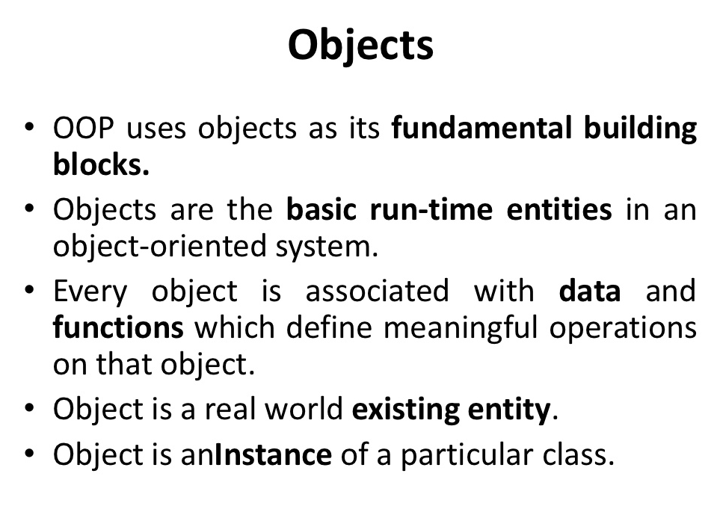

Slide 37
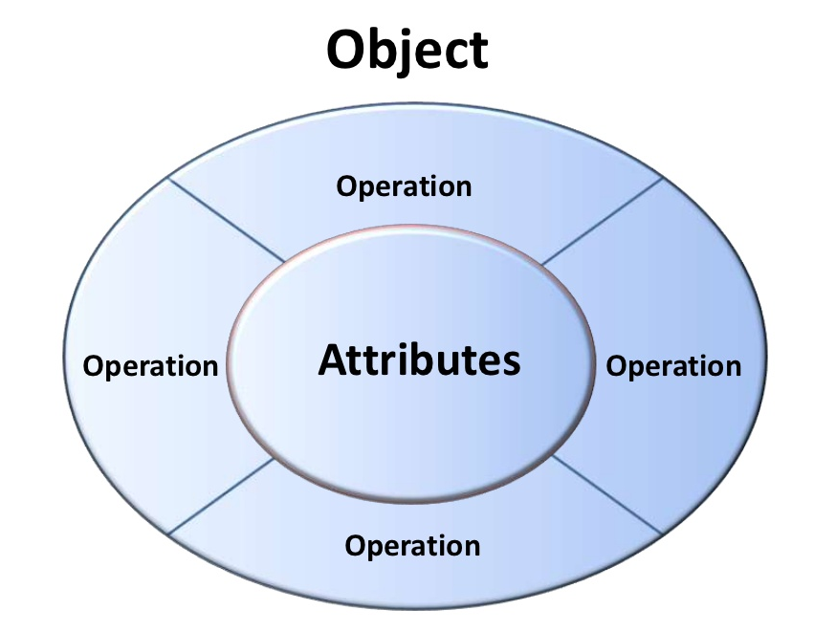

Slide 38
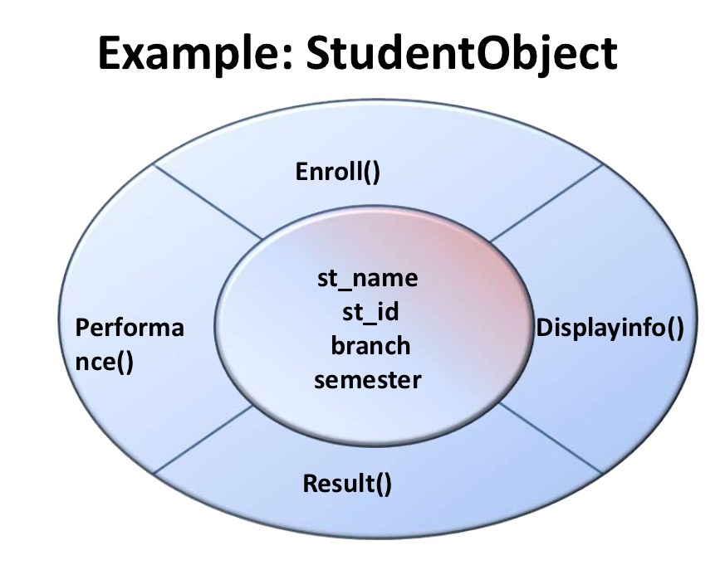

Slide 39
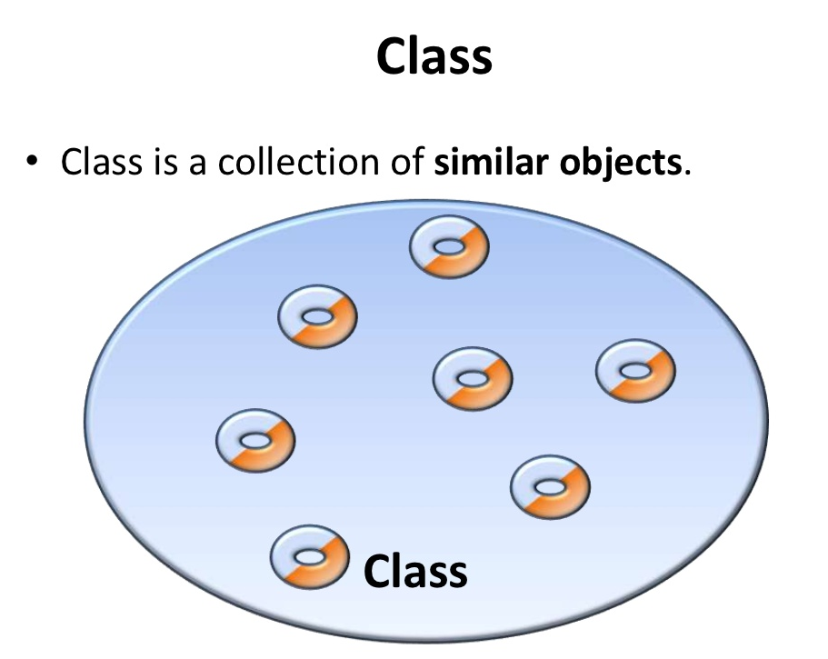

Slide 40
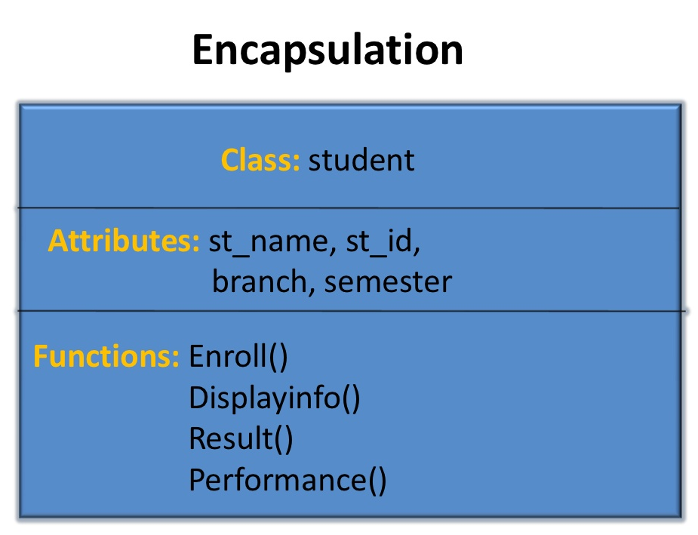

Slide 41
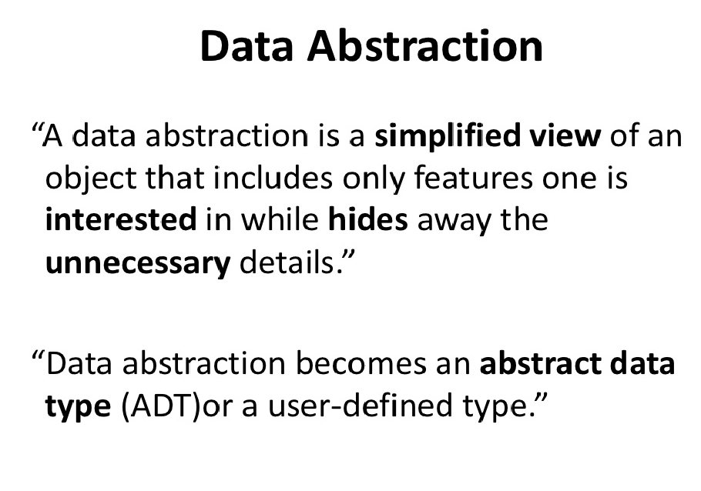

Slide 42
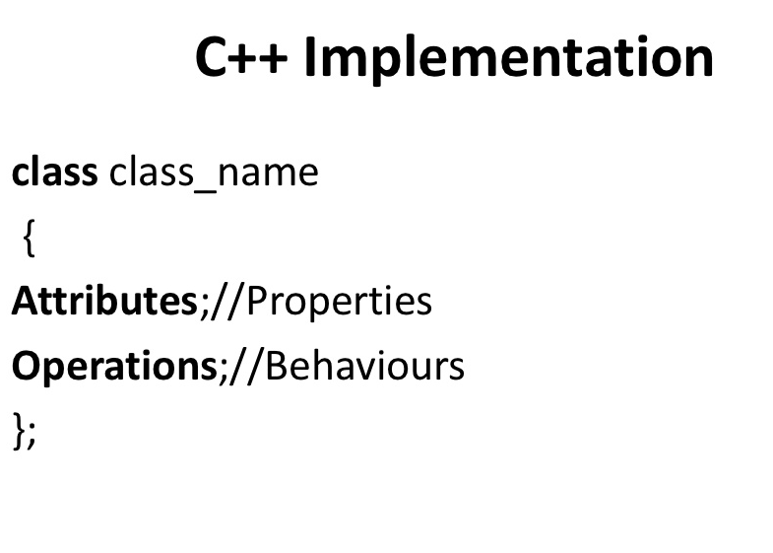

Slide 43
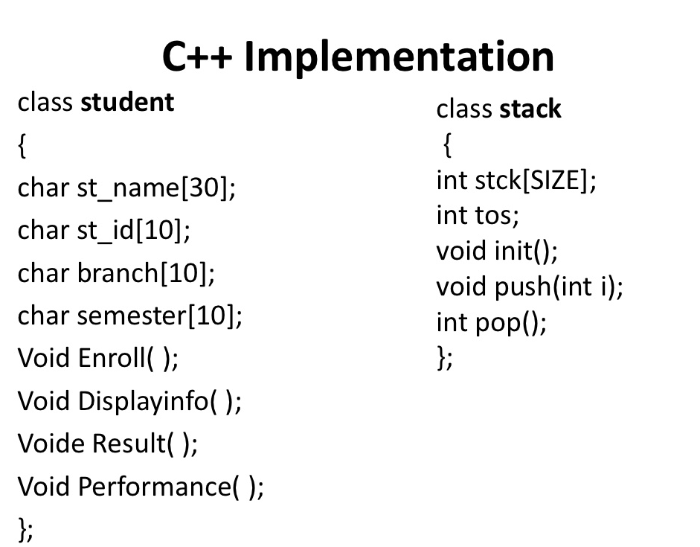

Slide 44
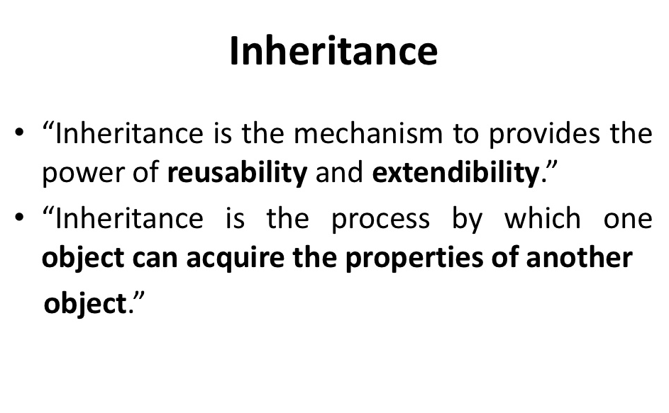

Slide 45
Contd…
As the name suggests Inheritance is the process of forming a new class from an existing class that is from the existing class called as base class, new class is formed called as derived class.
This is a very important concept of object-oriented programming since this feature helps to reduce the code size.

Slide 46
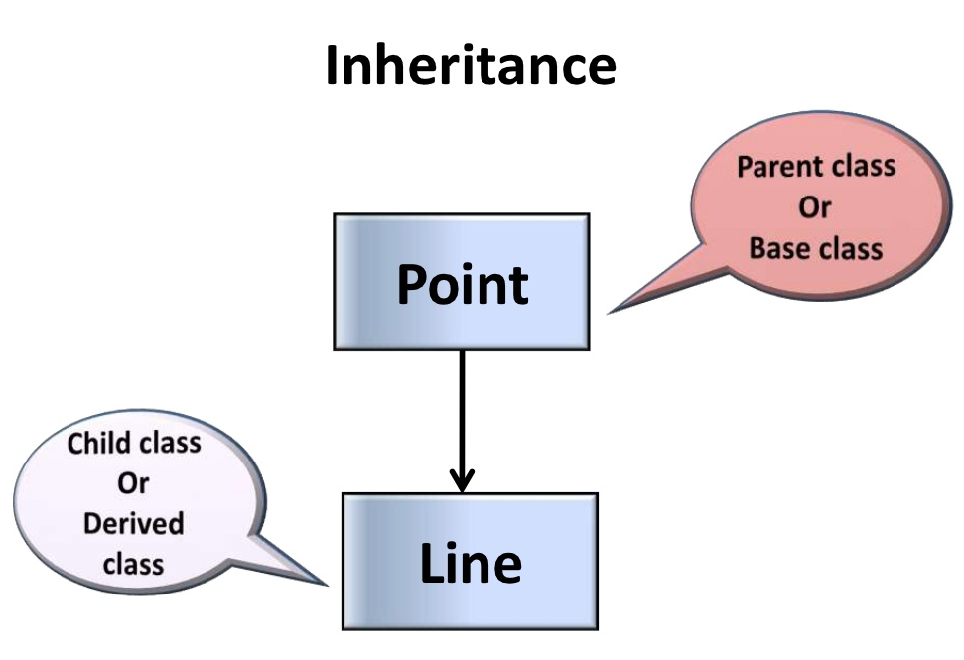

Slide 47
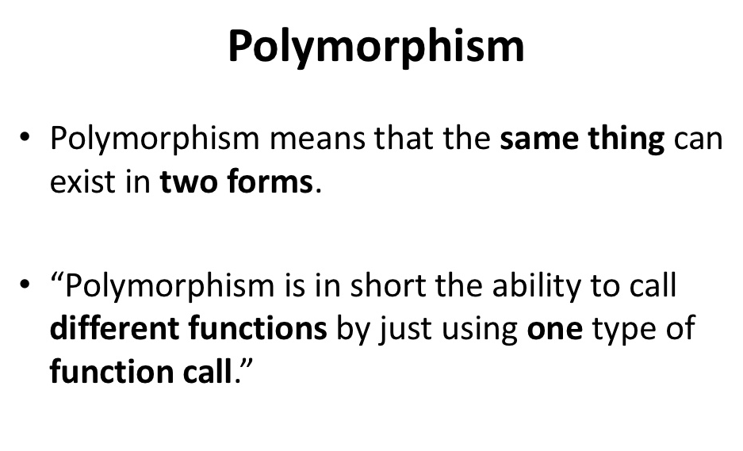

Slide 48
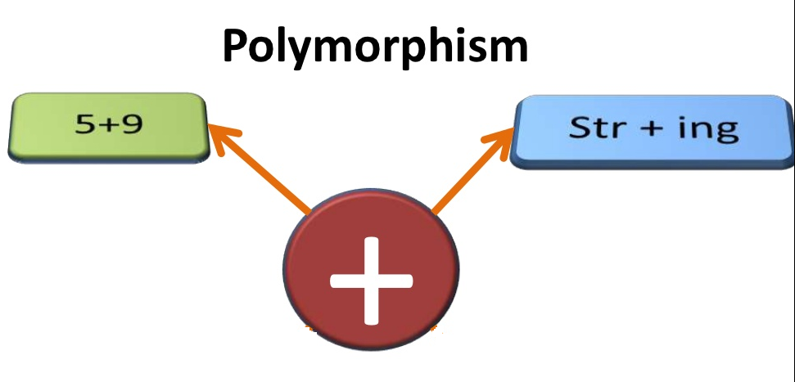

Slide 49
Dynamic Binding
“Dynamic Binding is the process of linking of the code associated with a procedure call at run-time”
Binding is the process of connecting one program to another
It is the process of linking the procedure call to a specific sequence of code or function at run time or during the execution of the program

Slide 50
Message Passing
“The process of invoking an operation on an object. In response to a message the corresponding method is executed in the object ”
In OOP, processing is done by sending message to objects
A message for an object is request for execution of procedure
Message passing involves specifying the name of the object, the name of the function(message) and the information to be sent

Slide 51
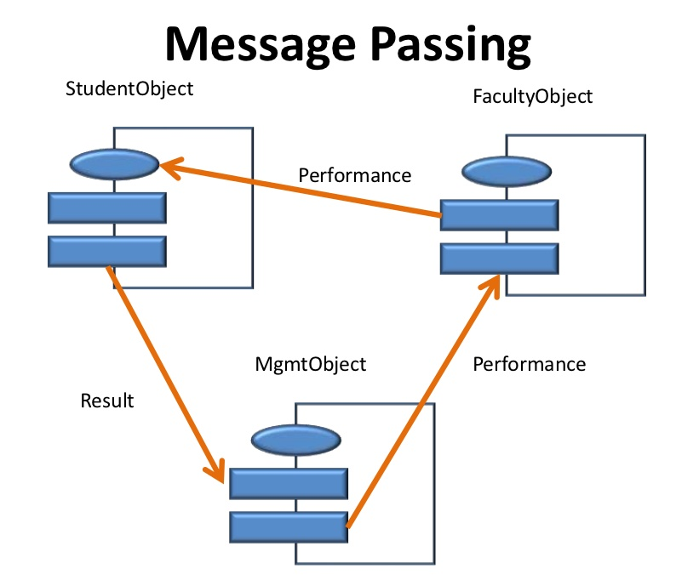

Slide 52
Namespaces
A namespace is used as additional information to differentiate similar functions, classes, variables etc. with the same name available in different libraries.
Using namespace, you can define the context in which names are defined.
In essence, a namespace defines a scope.

Slide 53
Defining a Namespace
A namespace definition begins with the keyword namespace followed by the namespace name as follows −
namespace namespace_name {
// code declarations
}
To call the namespace-enabled version of either function or variable, prepend (::) the namespace name as follows −
name::code; // code could be variable or function.

Slide 54
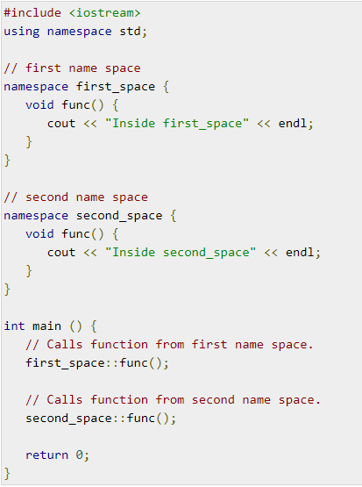
EXAMPLE

Slide 55
Output:
Inside first_space
Inside second_space

Slide 56
The using directive
You can also avoid prepending of namespaces with the using namespace directive
This directive tells the compiler that the subsequent code is making use of names in the specified namespace

Slide 57
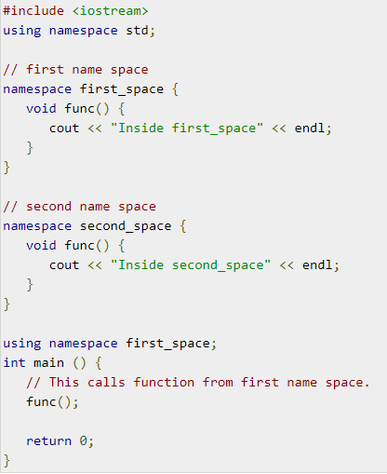
EXAMPLE

Slide 58
Output:
Inside first_space

Slide 59
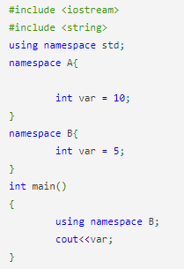
MCQ 1
A. 5
B. 10
C. Error
D. Wrong use of namespace

Slide 60
MCQ 1
A. 5
B. 10
C. Error
D. Wrong use of namespace

Slide 61
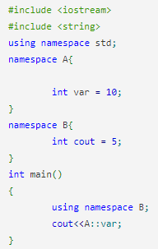
MCQ 2
A. 10
B. 5
C. Error
D. 105

Slide 62
MCQ 2
A. 10
B. 5
C. Error
D. 105

Slide 63
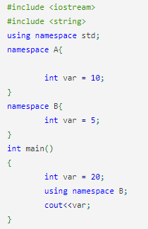
MCQ 3
A. 5
B. 10
C. Error
D. 20

Slide 64
MCQ 3
A. 5
B. 10
C. Error
D. 20

Slide 65
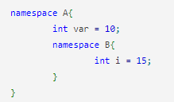
MCQ 4
How to print the value of i variable inside namespace B?
A. cout<<A::i;
B. cout<<B::i;
C. cout<<A::B::i;
D. cout<<i;

Slide 66
MCQ 4
How to print the value of i variable inside namespace B?
A. cout<<A::i;
B. cout<<B::i;
C. cout<<A::B::i;
D. cout<<i;

Slide 67
Objective
Objectives
Become familiar with the basic components of C++ program, including functions, identifiers
Explore simple data types
Outcome
Apply Object Oriented Programming concepts to solve various computing problems

Slide 68
Content
Structure of C++ program
A simple C++ program
Basic data types

Slide 69
Structure of C++ program
Include Files
Class declaration
Member functions definitions
Main function program

Slide 70
Writing first C++ program ()
//First program
#include <iostream>
int main()
{
std::cout<<“Hello World”;
return 0;
}

Slide 71
How to compile and run a C++ program?
Compiling C++ program
$ sudo g++ hello.cpp
OR
$ sudo g++ -o hello hello.cpp
Running C++ program
$ ./a.out (If you compiled using first command)
OR
$ ./hello (If you compiled using second command)

Slide 72
Comments
Comments are for the reader, not the compiler
Two types:
Single line (//)
// this is a c++ program
Multiple line (/* */)
/* you can include comments that can occupy several lines */

Slide 73
Pre-processor directives
We have to used the following #include directives in the program
#include<iostream>
This directive causes the pre-processor to add the contents of the iostream file to the program
Contains declaration for identifier cout and cin

Slide 74
namespace
It defines the scope for the identifiers
For using the identifiers defined in the namespace scope we must include the using directive, like
using namespace std;

Slide 75
Identifiers & Variable
Consist of letters, digits and the underscore character(_)
Must begin with a letter or underscore
C++ is case sensitive
NUMBER is not the same as number
Two predefined identifiers are cout and cin
Example
int num=10;

Slide 76
Whitespaces
Every C++ program contains whitespaces
Include blanks, tabs and newline characters
Used to separate special symbols, reserved words and identifiers
Proper utilization of whitespaces is important
Can be used to make the program readable

Slide 77
endl manipulator
To be inserted into the stream, so that subsequent text is displayed on the next line
It has the same effect as the ‘\n’ character

Slide 78

Output Operator
The statement is
cout<< “Enter the number”;
The identifier cout is actually an object
A stream is an abstraction that refers to a low of data
The operator << is called the insertion or put operator
cout
<<
“Enter”
Objects
Insertion operator
Variables

Slide 79

Input operator
The statement is
cin>> number;
The object cin is predefined in C++
The stream represents data coming from the keyboard
The >> operator is called the extraction
cin
>>
30.40
Keyboard
Object
Extraction operator
Variable

Slide 80
Cascading of I/O operators
You can also use the cin statement to read the more than one value input from the user by single statement instead of two statement as shown below
cin>>a>>b;
It is same as
cin>>a;
cin>>b;
Similarly we can even output multiple results in a single cout statement using cascading of stream insertion operator as shown below
cout <<“The addition of “<<a<<“and”<<b<<"=”<<a+b;

Slide 81
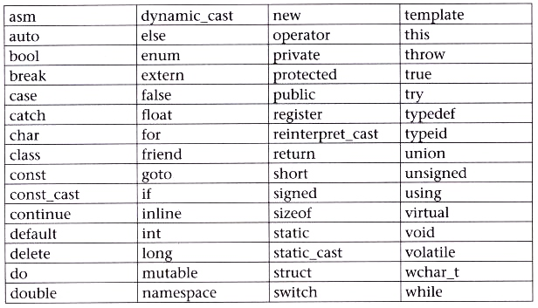
C++ keywords

Slide 82
Basic data types
C++ Data types
User- defined type
Structure
Union
Class
enumeration
Built-in type
Derived type
Array
Function
Pointer
reference
Integral type
void
Floating type
int
char
float
double

Slide 83
Size and range of c++ data types
Type | Bytes | Range
char | 1 | -28 to 127
unsigned char | 1 | 0 to 255
signed char | 1 | -128 to 127
int | 2 | -32768 to 32767
unsigned int | 2 | 0 to 65535
signed int | 2 | -31768 to 32767
short int | 2 | -31768 to 32767
unsigned short int | 2 | 0 to 65535
signed short int | 2 | -32768 to 32767
long int | 4 | -2147483648 to2147483647
signed long int | 4 | -2147483648 to2147483647
unsigned long int | 4 | 0 to 4294967295
float | 4 | 3.4E-38 to 3.4E+38
double | 8 | 1.7E-308 to 1.7E+308
long | 10 | 3.4E-4932 to 1.1E+4932

Slide 84
Basic Data Types
Integer data type: int
Example: int num = 10;
Real number data type: double
Example: double height = 1.68;
Character data type: char
Example: char letter = ‘a’;
Float data type: float
Example: float no = 50.2;

Slide 85
Operators
Arithmetic Operators
+,-,*,/,++, --
Relational Operators
<,>,<=,>=, ==, !=
Example: x<= y
a+b == c+d
m+n > 100
Logical Operators
&&, ||
Example: a> b && x== 10
y == 5

Slide 86
Operator (Cont..)
Bitwise Operators
&, |, ^, ~, <<, >>
Example: x << 2 //shift two bit position to left
y >> 1 //shift one bit position to right
Assignment Operators
=
Example: x = y = 5;
y = 10;

Slide 87
Increment and Decrement Operator
Increment Operator: increment variable by 1
Pre-increment: ++var
Post-increment: var++
Decrement Operator: decrement variable by 1
Pre-decrement: --var
Post-decrement: var—
What is the difference between the following?
X= 6;
Y = ++X;
X= 6;
Y = X++;

Slide 88
Order of precedence
Operators | Operations
() | Parentheses
* | Multiplication
/ | Division
% | Modulus
+ | Addition
- | Subtraction
Operator | Associatively
:: | Left to right
-> . () [] postfix ++ postfix – prefix ++ postfix-- ~ ! | Left to right
-> ** | Left to right
* / % | Left to right
+- | Left to right
<< >> | Left to right
<<= >>= | Left to right
== != | Left to right
& ^ | | Left to right
&& || | Left to right
=* =/ %= += = | Right to left

Slide 89
Write a program for Addition of Two numbers
// Python program
# Store input numbers
no1 = input('Enter first number: ')
no2 = input('Enter second number: ')
# Add two numbers
sum = int(no1) + int(no2)
# Display the sum
print('The sum of {0} and {1} is {2}'.format(no1, no2, sum))
// C++ program
#include <iostream>
using namespace std;
int main(){
int no1, no2, sum;
cout<<"Enter two numbers";
cin>> no1; //reads the numbers from keyboard
cin>> no2;
sum = no1 + no2;
cout <<“The sum of <<no1<<“and”<<no2<<“is”<<sum;
return 0;
}

Slide 90
Practice Problem
Write a C++ program to find the square root of the number.
Write a C++ program to convert Fahrenheit to Celsius.

Slide 91
Objective and Outcome
Objective
Learn about the structure
Outcome
Apply Object Oriented Programming concepts to solve various computing problems

Slide 92
Content
User Defined data types
Structure

Slide 93
User Defined Data Types
Structures
A structures is a collection of data items of different data type under a single name. Data items are called members
It behaves like a class in C++
A struct is heterogeneous
The size of a structure is the sum of the size of its members
The general syntax of structure is
Keyword
struct structure_name
{
data_type member_1;
data_type member_2;
data_type member_n;
} structure_variables;
tag
Member declaration
Structure variable name

Slide 94
Structures
Structures hold data that belong together
Examples:
Student record: student id, name, major, gender, start year, …
Bank account: account number, name, currency, balance, …
Address book: name, address, telephone number, …
In database applications, structures are called records
Example
struct StudentRecord{
char Name[10];
int Rollno;
char Dept[10];
char Gender;
};
The“StudentRecord” structure has 4 members

Slide 95
Declare Structure Variable
For structure variable declaration, the data type is the name of the structure followed by the structure variable name
Example, structure variable stud is defined as:
StudentRecord stud;
Structure variable name
Structure name

Slide 96
Accessing struct Members
The syntax for accessing a struct member is:
structure_variables.member;
The dot(.) is an operator, called member access operator
Example:
stud.age=18;

Slide 97
Initializing Structures
Example: First way
StudentRecord stud = {“Ram”, 1, “Computer”, ‘M’};
Second way
stud.name = “Ram”;
stud.Rollno = 1;
stud.Dept=“Computer”;
stud.Gender= ‘M’;

Slide 98
Program
//Output
Name: Ram
Age: 25
Salary: 30000
#include<iostream>
#include<string.h>
using namespace std;
struct Employee{
char name[100];
int age;
double salary;
};
int main(){
Employee empy;
strcpy(empy.name,“Ram");
empy.age=25;
empy.salary=30000;
cout<<“Employee Details”;
cout<<"Name :"<<empy.name<<endl;
cout<<"Age :"<<empy.age<<endl;
cout<<"Salary :"<<empy.salary<<endl;
return 0;
}

Slide 99
Program for keeping the track of books in library
#include <iostream>
#include <string.h>
using namespace std;
struct Books {
char title_book[50];
char author_book[50];
char subject[100];
int book_id;
};
int main() {
struct Books Book1; // Declare Book1 of type Book
struct Books Book2; // Declare Book2 of type Book
// Book 1 specification
strcpy( Book1.title_book, "Object Oriented Programming with C++");
strcpy( Book1.author_book, "Balagurusamy");
strcpy( Book1.subject, "Object Oriented Programming");
Book1.book_id =89648;

Slide 100
Program for keeping the track of books in library
// Book 2 specification
strcpy( Book2.title_book, "Object Oriented Programming in C++");
strcpy( Book2.author_book, "Robert Lafore");
strcpy( Book2.subject, "Object Oriented Programming")
Book2.book_id = 67590;
// Print Book1 information
cout << "Book 1 title : " << Book1.title_book<<endl;
cout << "Book 1 author : " << Book1.author_book <<endl;
cout << "Book 1 subject : " << Book1.subject <<endl;
cout << "Book 1 id : " << Book1.book_id <<endl;
// Print Book2 information
cout << "Book 2 title : " << Book2.title_book<<endl;
cout << "Book 2 author : " << Book2.author_book <<endl;
cout << "Book 2 subject : " << Book2.subject <<endl;
cout << "Book 2 id : " << Book2.book_id <<endl;
return 0;
}

Slide 101
struct basics
Declaration of a variable of struct type:
<struct-type> <identifier_list>;
Example:
Books Book1, Book2;
Book1 and Book2 are variables of Books type
title_book
author_book
subject
title_book
author_book
subject
Book1
Book2
Id
Id

Slide 102
Nested Structure
One structure contains another structure
Example:
struct Address
{
char HouseNo[25];
char City[25];
char PinCode[25];
};
struct Employee
{
int Id;
char Name[25];
float Salary;
struct Address Add;
};
Accessing member of employee
Employee emp;
emp.Id;
To access members in address
emp.Add.city.

Slide 103
Exercise
A phone number, such as (212) 767-8900, can be thought of as having three parts: the area code (212), the exchange (767), and the number (8900). Write a program that uses a structure to store these three parts of a phone number separately. Call the structure phone. Create two structure variables of type phone. Initialize one, and have the user input a number for the other one. Then display both numbers. The interchange might look like this: Enter your area code, exchange, and number: 415 555 1212 My number is (212) 767-8900 Your number is (415) 555-1212.
A point on the two-dimensional plane can be represented by two numbers: an x coordinate and a y coordinate. For example, (4,5) represents a point 4 units to the right of the vertical axis, and 5 units up from the horizontal axis. The sum of two points can be defined as a new point whose x coordinate is the sum of the x coordinates of the two points, and whose y coordinate is the sum of the y coordinates. Write a program that uses a structure called point to model a point. Define three points, and have the user input values to two of them. Then set the third point equal to the sum of the other two, and display the value of the new point. Interaction with the program might look like this: Enter coordinates for p1: 3 4 Enter coordinates for p2: 5 7 Coordinates of p1+p2 are: 8, 11

Slide 104
Objective and Outcome
Objective
Learn about the enum and classes
Outcome
Apply Object Oriented Programming concepts to solve various computing problems

Slide 105
Content
User Defined data types
Enumeration
Classes

Slide 106
User Defined Data Types
Enumeration
Enumerated data type provides a way for attaching names to numbers
Note: By default, the enumerators are assigned integer values starting with 0. We can override the default by explicitly assigning integer values to the enumerators
The general syntax of enum declaration
keyword
Enumeration name
enum week {sunday, monday, tuesday, wednesday, thursday, friday, saturday };
List of constant separated by commas

Slide 107
Need of Enumeration
Enums can be declared in the local scope
int main(){
enum Bool{True, False} var;
var= True;
cout<<"variable value="<<var;
return 0;
}
Enum name are automatically initialized by compiler
int main(){
enum Bool{True, False} var;
var= True;
cout<<"variable value="<<var;
return 0;
}
This enum is not visible to the outside this main function
True is initialized to 0 and False to 1

Slide 108
Important Facts
Two or more names can have same value
int main(){
enum point{ x = 1, y = 1, z = 1};
cout<<x<<y<<z;
return 0;
}
We can assign values in any order. All unassigned names will get value as value of previous name+1
int main(){
enum value { y = 20, x = 1, z, m};
cout<<x<<y<<z<<m;
return 0;
}
Only integral values are assigned
int main(){
enum value {x = 1.3, z,};
cout<<x<<z;
return 0;
}
Enumerated value of x is not an integer constant

Slide 109
Program
#include <iostream>
using namespace std;
//specify enum type
enum days_of_week { Sun, Mon, Tue, Wed, Thu, Fri, Sat };
int main()
{
int diff;
days_of_week day1, day2; //define variables of type days_of_week
day1 = Tue; //give values to
day2 = Fri; //variables
diff = day2 - day1; //can do integer arithmetic
cout << "Days between = " << diff << endl;
if(day1 < day2) //can do comparisons
cout << "day1 comes before day2\n";
return 0;
}
Output:
Day: 3

Slide 110
User Defined Data Types
Classes
A class is a blueprint for any functional entity which defines its properties and its functions.
A class contains data members/ attributes
It offers data abstraction/ encapsulation of OOP
Classes are similar to structure as it aggregates the data logically
Collection of objects

Slide 111
Syntax
keyword
Classname
class classname
{
Access specifiers:
Member variable declaration;
Member function declaration;
};
Private/public/protected
End of class with a semicolon

Slide 112
Objects
An object is an instance of a class
Objects are the basic run time entities in an object-oriented system
Syntax:
class_name variable_name;

Slide 113
Program
#include <iostream>
using namespace std;
// Class Declaration
class Employee{
//Access - Specifier
public:
string name; //Variable Declaration
int number;
};
//Main Function
int main() {
// Object Creation For Class
Employee obj;
//Get Input Values For Object Variables
cout << "Enter the Name :";
cin >> obj.name;
cout << "Enter the Number :";
cin >> obj.number;
//Show the Output
cout << obj.name << ": " << obj.number << endl;
return 0;
}

Slide 114
Difference between structure and class
By default, all data fields of a struct are public. However by default, all data fields of a class are private
The struct defined in (a) can be replaced by class defined in (b) by using public access modifier
struct Student{
int id;
string firstname;
};
class Student{
public:
int id;
string firstname;
};
(b)
(a)

Slide 115
Control Structure – Looping Structure
Learning Outcome
Write simple program using the looping control structure

Slide 116
Control structures
Control Structures
Selection
Sequence
Loop
if-else
switch
do-while
while, for
Two way branch
Multiple branch
Exit control
Entry control

Slide 117
HOW TO BUILD A CODING USING A REPETITION/ LOOPING CONTROL STRUCTURE
The looping control structure:
The while Construct
For Construct

Slide 118
Example 1: while Construct
Previous Lesson:
Remember to plan your algorithm.
Do Problem Analysis.
Transfer to Pseudocode or Flow Chart.

Slide 119
Examples of programming the use of looping control structure-while
Example 1
Problem Statement:
Calculate the area of a rectangle for 3 times using while-loop
width
height

Slide 120
Examples of programming the use of looping control structure
STEP 1
Identify the control structure based on the problem statement given:
Control Structure : looping

Slide 121
Examples of programming the use of sequential control structure
STEP 2
Identify The Problem & the Formula to be used :
Problem : Calculate the area of rectangle 3 times
Formula : area = width * height

Slide 122
STEP 3
Problem Analysis:
Identify The Input, Process and Output:
Input | Process | Output
width height | area = width x height | area

Slide 123
STEP 4 : Planning The Algorithm:
Pseudocode
start
1. initialize counter i = 1
2. while (i <= 3)
3. read width, height
4. calculate area of rectangle
area = width * height
5. print area
6. counter increment
i = i + 1
7. repeat step 2
end
initial value of counter
condition to test
IPO analysis
increment to modify the loop
Repeat step 2 – 6 until expression is false

Slide 124
STEP 5
Convert
to a
C + + Program:

Slide 125
Looping - while
int i=1;
Initial value of control variable
while( i <=3)
Loop-continuation condition
{
/*Create the braces because statements block are more than one, otherwise it will create an infinity result output*/
Process items inside looping are based on condition given
i = i +1;
counter increment
}

Slide 126
Segment of C++ Program (while)
float width, height, area;
int i=1;
while(i<=3)
{
cout <<" Enter width : ";
cin>> width; cout <<" Enter height : ";
cin>> height;
area=width * height;
cout <<"Rectangle area: "<<area;
cout <<endl;
i= i +1;
}
Initial value of control variable
Loop-continuation condition
Process items inside looping are based on condition given
counter increment

Slide 127
The for Statement
for is an entry-controlled loop
It is used when an action is to be repeated for a predetermined number of times
Semicolons separate the items in the for loop block
There is no semicolon at the end of the for loop definition at the beginning of the statement
Syntax
for (initialization; condition; update)
{
// body of-loop
}
Initialization expression
Test Condition
Increment/
decrement

Slide 128
Example of Repetition
num
1
int num;
num <= 3 ; num++ )
cout << “Number:”<< num << endl;
for ( num = 1 ;
OUTPUT

Slide 129
Example of Repetition
num
1
int num;
for ( num = 1 ; num++ )
cout << “Number:”<< num << endl;
true
num <= 3 ;
OUTPUT

Slide 130
Example of Repetition
num
1
int num;
for ( num = 1 ; num <= 3 ; num++ )
cout << “Number:”<< num << endl;
OUTPUT
Number:1

Slide 131
Example of Repetition
num
2
int num;
for ( num = 1 ; num <= 3
cout << “Number:”<< num << endl;
; num++ )
OUTPUT
Number:1

Slide 132
Example of Repetition
num
2
int num;
for ( num = 1 ; num++ )
cout << “Number:”<< num << endl;
true
num <= 3 ;
OUTPUT
Number:1

Slide 133
Example of Repetition
num
2
int num;
for ( num = 1 ; num <= 3 ; num++ )
cout << “Number:”<< num << endl;
OUTPUT
Number:1
Number:2

Slide 134
Example of Repetition
num
3
int num;
for ( num = 1 ; num <= 3 ;
cout << “Number:”<< num << endl;
num++)
OUTPUT
Number:1
Number:2

Slide 135
Example of Repetition
num
3
int num;
for ( num = 1 ; ; num++ )
cout << “Number:”<< num << endl;
true
num <= 3
OUTPUT
Number:1
Number:2

Slide 136
Example of Repetition
num
3
int num;
for ( num = 1 ; num <= 3 ; num++ )
cout << “Number:”<< num << endl;
OUTPUT
Number:1
Number:2
Number:3

Slide 137
Example of Repetition
num
4
int num;
for ( num = 1 ; num <= 3 ;
cout << “Number:”<< num << endl;
num++ )
OUTPUT
Number:1
Number:2
Number:3

Slide 138
Example of Repetition
num
4
int num;
for ( num = 1 ; ; num++ )
cout << “Number:”<< num << endl;
false
num <= 3
OUTPUT
Number:1
Number:2
Number:3

Slide 139
Example of Repetition
num
4
int num;
for ( num = 1 ; ; num++ )
cout << “Number:”<< num << endl;
false
num <= 3
When the loop control condition
is evaluated and has value false, the
loop is said to be “satisfied” and
control passes to the statement
following the for statement.

Slide 140
Segment C++ Program (for- loop)
{ float width, height, area;
int i;
for (i=1; i<=3; i=i+1) {
cout <<" Enter width : ";
cin>> width; cout <<" Enter height : ";
cin>> height;
area=width * height;
cout <<"Area of rectangle : "<<area;
cout <<endl;
}
}
(i)
(ii)
(iii)
i) Initial value of control variable
ii) Loop-continuation condition
iii) Counter increment
Process items inside looping are based on condition given

Slide 141
Nested Loops
Recall when a control structure is contained within another control structure, the inner one is said to be nested.
You may have repetition within decision and vice versa.
if ...
for...
for ...
for ...

Slide 142
The do…while Loop
•The general form of a do...while statement is:
do
statement
while (expression);
•The statement executes first, and then the expression is evaluated
•If the expression evaluates to true, the statement executes again
•As long as the expression in a do...while statement is true, the statement executes

Slide 143
The do…while Loop (continued)
•To avoid an infinite loop, the loop body must contain a statement that makes the expression false
•The statement can be simple or compound
•If compound, it must be in braces
•do...while loop has an exit condition and always iterates at least once (unlike for and while)

Slide 144
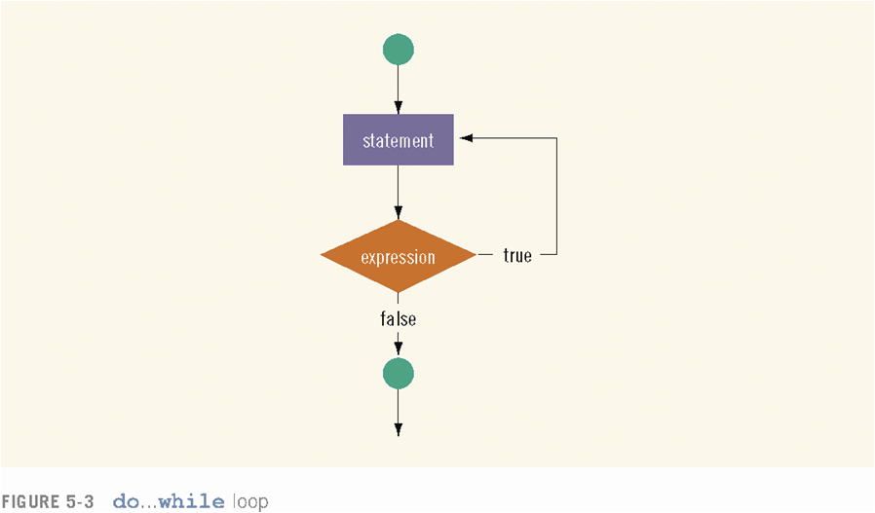

Slide 145
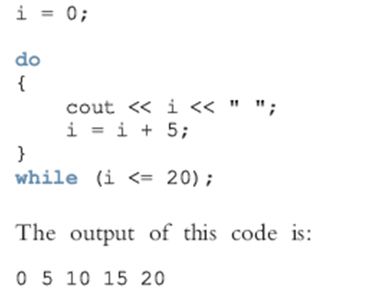
Example

Slide 146
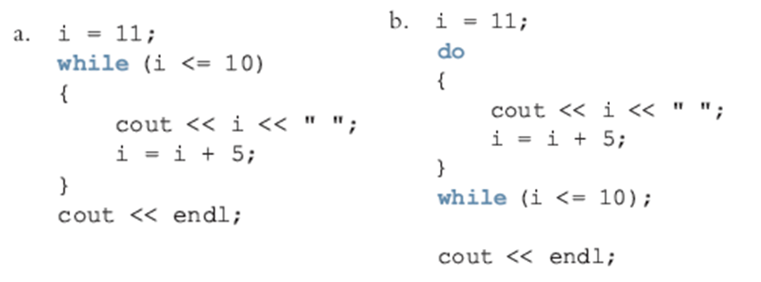
Difference between while and do-while

Slide 147
Selection

Slide 148
if statement
•Two-way selection takes the form:
if (expression)
statement1;
else
statement2;
•If expression is true, statement1 is executed otherwise statement2 is executed
•statement1 and statement2 are any C++ statements
•else is a reserved word

Slide 149
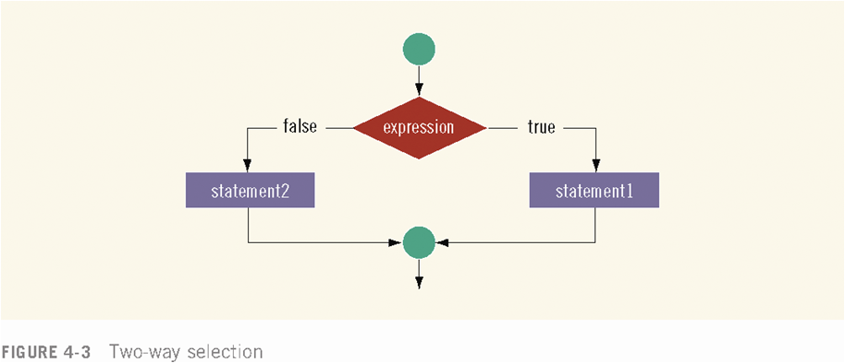

Slide 150
Example
int x = 10;
if ( x % 2 == 0 )
{
cout << “x is even”;
}
else
{
cout << “x is odd”;
}
cout << “, done” << endl;
x is even, done

Slide 151
if…else Double-Selection Statement
Ternary conditional operator (?:)
– Three arguments (condition, value if true, value if false)
Code could be written:
cout << ( grade >= 60 ? “Passed” : “Failed” );
Condition Value if true Value if false

Slide 152
Nested if
Nesting: one control statement in another
An else is associated with the most recent if that has not been paired with an else

Slide 153
Example
if ( studentGrade >= 90 )
cout << ‘A’;
else if (studentGrade >= 80 )
cout << ‘B’;
else if (studentGrade >= 70 )
cout << ‘C’;
else if ( studentGrade >= 60 )
cout << ‘D’;
else
cout << ‘F’;

Slide 154
switch Structures
Used to select among statements from several alternatives
In some cases, can be used instead of if/else if statements
Syntax:
switch (expression) //integer
{
case exp1: statement1;
case exp2: statement2;
...
case expn: statementn;
default: statementn+1;
}

Slide 155
break Statement
Used to exit a switch statement
If it is left out, the program "falls through" the remaining statements in the switch statement

Slide 156
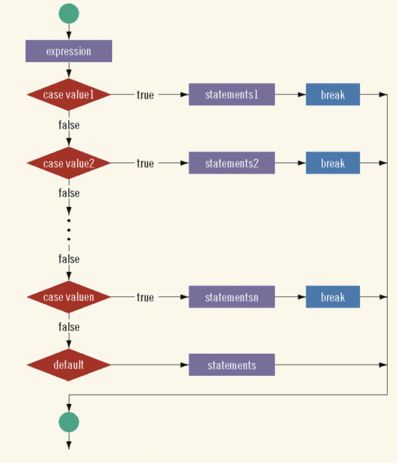

Slide 157
Example
#include <iostream>
using namespace std;
int main()
{
char grade; cout << "Enter your grade: "; cin >> grade; cout << endl;
switch (grade)
{
case 'A':
cout << "Your grade is A." << endl;
break;
case 'B':
cout << "Your grade is B." << endl;
break;
case 'C':
cout << "Your grade is C." << endl;
break;
case 'F':
case 'f':
cout << "Your grade is D." << endl;
break;
default:
cout<<" The grade is invalid."<<endl;
}
return 0;
}

Slide 158
Practice Problem
Create a Calculator using the switch Statement

Slide 159
Arrays

Slide 160
Objectives and Outcome
Objectives
Declare, initialize and manipulate a one dimensional array
Outcomes
Apply Object Oriented Programming concepts to solve various computing problems

Slide 161
Contents
Array
Types of Array
Examples of Array

Slide 162
Array
An array is a group of consecutive memory locations with same name and data type
It is a collection of variables of the same type that are referenced by a common name
Each component is accessed by an index that indicates the component’s position within the collection
Example: Instead of declaring roll1, roll2,… we can directly declare roll[60] in which roll[1], roll[2], … are considered as individual variables
Declaration of an array
type name [elements];
Base type
Name of array
Size of an array

Slide 163
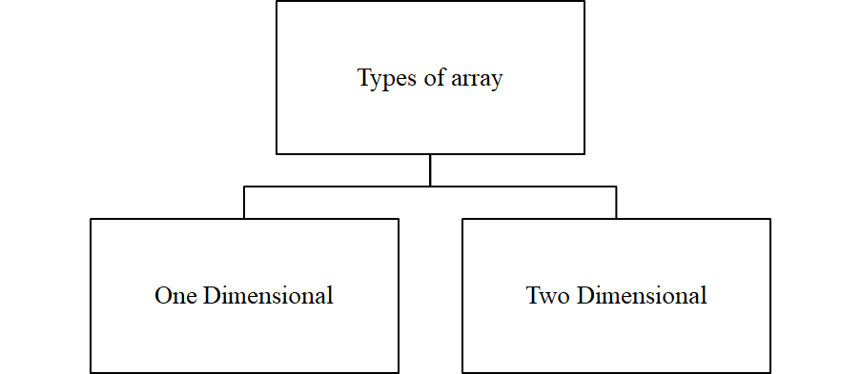
Types of Array

Slide 164
One Dimensional Array(1-D)
A type of array in which all elements are arranged in the form of a list is known as 1-D array or single dimensional array or linear list
Each variable in a one-dimensional array is identified by a unique number called a subscript
Declaring Array
int num [5];
int num [5]={10, 20, 50, 60, 90};
int num[]={10, 20, 50, 60, 90};

Slide 165
Memory representation
Array indices
num[0]
num[1]
num[2]
num[3]
num[4]
Value
10
20
50
60
90
Addresses
2000
2002
2004
2006
2008
Address of First element
Address of Last element

Slide 166
Program to calculate the percentage of student marks
int main(){
int no, i;
float marks[10], per=0, total=0;
cout<<"Enter number of subject: ";
cin>>no;
cout<<"Enter marks of "<<no<<" subjects";
for(i=0; i<no; i++)
{
cin>>marks[i];
}
for(i=0; i<no; i++)
{
total=total+marks[i];
}
per=total/no;
cout<<"\n Total marks: "<<total;
cout<<"\n Percentage: "<<per;
}

Slide 167
Practice Problem
Take 5 integer inputs from user and print the following:
number of positive numbers
number of negative numbers
number of odd numbers
number of even numbers
number of 0.

Slide 168
Arrays, Strings and Classes

Slide 169
Objectives and Outcome
Objectives
Declare, initialize and manipulate a two dimensional array
Outcomes
Apply Object Oriented Programming concepts to solve various computing problems

Slide 170
Contents
2D Array
Examples of Array
Strings
Classes

Slide 171
Two Dimensional array(2D)
Two dimensional array resembles a table
Variables or elements are identified by a unique combination of two subscripts
Arrays with two dimensions often represent tables of values consisting of information arranged in rows and columns
Declaration
Type arrayName[numberOfRows][numberOfColumn];

Slide 172
Two Dimensional array(2D)- Declaration
Example
int x[2][3];
int x[2][3]={2,4,5,9,6,7};
int x[2][3]={{2,4,5},{9,6,7}};
Column 0
Column 1
Column 2
Row 0
x[0][0] | x[0][1] | x[0][2]
x[1][0] | x[1][1] | x[1][2]
Row 1
Row Index
Column Index

Slide 173
Display a Matrix
int main(){
int mat[5][5],row, col, i, j;
cout<<"Enter the number of rows and columns";
cin>>row>>col;
cout<<"Enter the elements of matrices";
for(i=0;i<row;i++) {
for(j=0;j<col;j++) {
cin>>mat[i][j];
}
}
cout<<"Matrix one is:\n";
for(i=0;i<row;i++) {
for(j=0;j<col;j++) {
cout<<mat[i][j]<<"\t";
}
cout<<"\n";
}
return 0;
}

Slide 174
Practice Problem
C++ program for the addition of two matrix

Slide 175
Strings
A string is a sequence of character
Every string is terminated by a null character (‘\0’)
To manipulate easy ANSI committee added a new class called string
It allows us to define objects of string type and they can be used as built in data types
The programmer should include the <string.h> header file

Slide 176
String manipulation functions
Function | task
append() | Adds one string at the end of another string
assign() | Assigns a specified part of string
at() | Access a characters located at given location
begin() | returns a reference to the beginning of a string
capacity() | calculates the total elements that can be stored
compare() | compares two strings
empty() | returns false if the string is not empty, otherwise true
end() | returns a reference to the termination of string
erase() | erases the specified character
find() | finds the given sub string in the source string
insert() | inserts a character at the given location
length() | calculates the total number of elements in string
replace() | substitutes the specified character with the given string
resize() | modifies the size of the string as specified
size() | provides the number of character n the string
swap() | Exchanges the given string with another string

Slide 177
String Relational Operators
Operator | Working
= | Assignment
+ | Joining two or more strings
+= | Concatenation and assignment
== | Equality
!= | Not equal to
< | Less than
<= | Less than or equal
> | Greater than
>= | Greater than or equal
[] | Subscription
<< | Insertion
>> | Extraction

Slide 178
Calculate the length of string
#include<string.h>
#include<iostream>
using namespace std;
int main()
{
string small;
small = "I am short";
cout << "The short string is " << small.length() << " characters." << endl;
return 0;
}

Slide 179
Inserting string using insert()
#include<string.h>
#include<iostream>
using namespace std;
int main()
{
string s1(“Hello”);
string s2(“Hi”);
cout<<“s1:”<<s1<<endl;
cout<<“s2:”<<s2<<endl;
cout<<“After Insertion:”<<endl;
s1.insert(3, s2);
cout<<“s1:”<<s1<<endl;
cout<<“s2:”<<s2<<endl;
return 0;
}

Slide 180
Relational Operations on string objects
#include<string.h>
#include<iostream>
using namespace std;
int main() {
string s1("Hello");
string s2("World");
string s3=s1+s2;
if(s1!=s2)
cout<<s1<<" is not equal to"<<s2<<endl; if(s1>s2)
cout<<s1<<" is greater than"<<s2<<endl; else
cout<<s2<<" is greater than"<<s1<<endl; if(s3 == s1+s2)
cout<<s3<<" is equal to "<<s1+s2<<endl;
int x = s1.compare(s2);
if(x==0)
cout<<s1<<" = "<<s2<<endl;
else if(x>0)
cout<<s1<<" > "<<s2<<endl;
else
cout<<s1<<" < "<<s2<<endl;
return 0;
}

Slide 181
Comparing and swapping the two string
#include<string.h>
#include<iostream>
using namespace std;
int main()
{
string s1("Hello");
string s2("World");
cout<<“\n Before swap”;
cout<<“s1 = ”<<s1<<endl;
cout<<“s2 = ”<<s2<<endl;
s1.swap(s2);
cout<<“\n After swap”;
cout<<“s1 = ”<<s1<<endl;
cout<<“s2 = ”<<s2<<endl;
return 0;
}

Slide 182
Specifying a class
A class is a way to bind the data and its associated functions together
Create a new abstract data type
Class specification have two parts
Class declaration
Class function definitions
The general form of class declaration
class class_name{
private:
variable declarations;
function declarations;
public:
variable declarations;
function declaration;
};

Slide 183
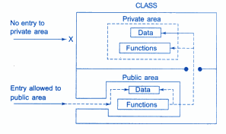
Data hiding in classes

Slide 184
A simple class Example
class Rectangle {
int width, height;
public:
void set_values (int,int);
int area (void); //function declaration using prototype
} rect; //ends with semicolon
Object

Slide 185
Example
//
class Rectangle {
int width, height;
public:
void set_values (int,int);
int area() {
return width*height;
}
};
void Rectangle::set_values (int x, int y) {
width = x;
height = y;
}
int main () {
Rectangle rect;
rect.set_values (3,4);
cout << "area: " << rect.area();
return 0;
}

Slide 186
Access-specifier private
Makes any member accessible only to member functions of the class
May be applied to data members and member functions
Encourages “information hiding”

Slide 187
Example
class student{
private:
int rollno;
public:
void putdata(int r){
rollno=r;
cout<<”\n Roll No:”<<rollno; }
};
int main(){
student stud;
int roll;
cout<<”\n Enter the roll no”;
cin>>roll;
stud.putdata(roll);
return 0;
}

Slide 188
Access-specifier public
Public members may be accessed by member functions of same class and functions outside the scope of the class
The member functions are normally declared as public

Slide 189
Example
class student{
public:
int rollno;
void putdata(){
cout<<”Roll No”<<rollno;
}
};
int main(){
student stud;
cout<<”\n Enter the Roll No”;
cin>>stud.rollno;
stud.putdata();
return 0;
}

Slide 190
Access-specifier protected
It is a stage between private and public access
If a member functions defined in a class are protected, they cannot be accessed from outside the class
But can be accessed from derived class

Slide 191
Example
class Sample {
protected:
int rollno;
};
class SampleChild : public Sample {
public:
void displayAge(int r) {
rollno = r;
cout << "Roll No = " << rollno << endl;
}
};
int main() {
int roll;
SampleChild child;
cout << "Enter your Roll No: ";
cin >> roll;
child.displayAge(roll);
return 0;
}

Slide 192
Classes, Objects, Constructor & Destructor

Slide 193
Content
Access-specifier private
Arrays of Objects
Class Scope and Accessing Class Members
Constructors
Destructor

Slide 194
Arrays of Objects
As an array can be of any data type
We can also have arrays of variable that are of the type class. Such variables are called array of objects
Example
class student{
private: float per;
public: int regno, age;
void getdata();
void show();
};

Slide 195
Example
class student{
char name[15];
float age;
public:
void getdata();
void putdata();
};
void student::getdata()
{
cout<<"Enter Name";
cin>>name;
cout<<"Enter Age";
cin>>age;
}
void student::putdata()
{
cout<<"Name:"<<name<<endl;
cout<<"Age:"<<age<<endl;
}

Slide 196
const int size=2;
int main(){
student s[size];
int i;
for(i=0;i<size;i++)
{
cout<<"Detail of student"<<i+1<<endl;
s[i].getdata();
}
cout<<"\n";
for(i=0;i<size;i++)
{
cout<<"\n student"<<i+1<<"\n";
s[i].putdata();
}
return 0;
}

Slide 197
Class Scope and Accessing Class Members
Outside a scope
Use handles
An object name, a reference to an object or a pointer to an object
Accessing class members
Same as structs
Dot (.) for objects and arrow (->) for pointers
Example: t.hour is the hour element of t
TimePtr->hour is the hour element

Slide 198
1. Class definition 1.1 Initialize object 2. Print using the dot operator 2.2 Set new value 2.3 Print using a reference
1 // Fig. 16.3: fig16_03.cpp
2 // Demonstrating the class member access operators . and ->
3 //
4 // CAUTION: IN FUTURE EXAMPLES WE AVOID PUBLIC DATA!
5 #include <iostream>
6
7 using std::cout;
8 using std::endl;
9
10 // Simple class Count
11 class Count {
12 public:
13 int x;
14 void print() { cout << x << endl; }
15 };
16
17 int main()
18 {
19 Count counter, // create counter object
20 *counterPtr = &counter, // pointer to counter
21 &counterRef = counter; // reference to counter
22
23 cout << "Assign 7 to x and print using the object's name: ";
24 counter.x = 7; // assign 7 to data member x
25 counter.print(); // call member function print
26
27 cout << "Assign 8 to x and print using a reference: ";
28 counterRef.x = 8; // assign 8 to data member x
29 counterRef.print(); // call member function print
30

Slide 199
2.3 Set new value 2.4 Print using a pointer Program Output
31 cout << "Assign 10 to x and print using a pointer: ";
32 counterPtr->x = 10; // assign 10 to data member x
33 counterPtr->print(); // call member function print
34 return 0;
35 }
Assign 7 to x and print using the object's name: 7
Assign 8 to x and print using a reference: 8
Assign 10 to x and print using a pointer: 10

Slide 200
Constructors
Constructor function
Can initialize class members
Same name as the class, no return type
Member variables can be initialized by the constructor or set afterwards
Declaring objects
Initializers can be provided
Initializers passed as arguments to the class’ constructor

Slide 201
Constructors
Example
Class student{
private:
int rollno;
float marks;
public:
student() //constructor
{
rollno =0 ;
marks =0.0 ;
}
};

Slide 202
Default Constructor
It takes no arguments
It is used to initialize an object of a class with legal initial values
Example:
class student{
private:
int rollno;
float marks;
public:
student()
{
rollno=0;
marks=0.0;
}
};
int main(){
student s1;
}

Slide 203
Parameterized Constructor
Parametrized constructor accepts arguments
It initializes the data members of the object with the arguments passed to it
Example:
class student{
private:
int rollno;
float marks;
string name;
public:
student()
{ rollno=0; marks=0.0; }
student(int roll, string nam, float mar)
{
rollno= roll;
name = nam;
marks = mar;
}

Slide 204
Parameterized Constructor (Cont..)
void display(){
cout<<"Roll no"<<rollno<<endl; cout<<"Name"<<name<<endl; cout<<"Marks"<<marks<<endl;
}
};
int main(){
student s1;
student s2(1, “ram”, 250);
student s3 = student(2, “shyam”, 300);
s1.display();
s2.display();
s3.display();
return 0;
}

Slide 205
Copy constructor
Copy constructor accepts an object as an argument
It creates a new object and initializes its data members of the object passed to it as an argument
Syntax
class_name(class_name &object_name)
{
…………………
………………..
}

Slide 206
Destructor
Member function of class
Complement of the constructor
Name is tilde (~) followed by the class name
Recall that the constructor’s name is the class name
Receives no parameters, returns no value
One destructor per class - no overloading allowed

Slide 207
Example
class student{
private:
int rollno;
float marks;
string name;
public:
student(){
rollno=0; marks=0.0;
cout<<"Default constructor \n";
}
student(int roll, string nam, float mar){
rollno= roll;
name = nam;
marks = mar;
cout<<"Parametrized constructor \n";
}
student(student &s){
rollno=s.rollno;
name= s.name;
marks=s.marks;
cout<<"Copy constructor \n";
}

Slide 208
~student()
{
cout<<“Destructor\n”;
}
void display(){
cout<<"Roll no"<<rollno<<endl; cout<<"Name"<<name<<endl; cout<<"Marks"<<marks<<endl;
}
};
int main(){
student s1;
student s2(1, “ram”, 250);
student s3 (s2);
s1.display();
s2.display();
s3.display();
return 0;
}

Slide 209
Exercise
Define a class to represent a bank account. Include the following members
Data Member
Name of depositor, account number, type of account, balance amount in account
Member function
To assign initial values
To deposit an amount
To withdraw an amount after checking the balance
To display name and balance
Write a main program to test the program

Slide 210
Functions

Slide 211
Content
Function
Function Prototyping
Calling a function
Objects and Memory requirements
Static Data Members
Static member function

Slide 212
Functions
Dividing a program into functions
A major principle of top-down, structured programming
To reduce the size of the program
Code re-use
Like C++ operators, a C++ function can be overloaded to make it perform different tasks depending on the arguments passed

Slide 213
Syntax
void show(); // Function Declaration
void main()
{
--------
show(); //function call
}
void show() //function definition
{
--------
-------- // function body
}

Slide 214
The main() function
The main() returns a value of type int to the operating systems by default
The functions that have a return value should use the return statement for termination
Use void main(), if the function is not returning any value

Slide 215
Function Prototyping
The prototyping describes the function interface to the compiler by giving details such as
The number and type of arguments
The type of return values
It is a template
When the function is called , the compiler uses the template to ensure that proper arguments are passed, and the return value

Slide 216
Function Prototyping (Cont..)
Function prototype is a declaration statement the calling program
type function_name (argument_list);
The argument list contains the types and name of arguments that must be passed to the functions
Each argument variable must be declared independently inside the parentheses
float avg (int x, int y, int z); //correct
float avg (int x, y); //illegal
In a function declaration, the names of the arguments are dummy variables and therefore they are optional

Slide 217
Function Prototyping (Cont..)
float avg(int, int);
The variable names in the prototype just act as placeholders and, therefore, if names are used, they do not have to match the names used in the function call or function definition
void display(); //function with an empty argument list
void display(void);

Slide 218
Calling a function
A function is called by specifying its name followed by its arguments
Non-value returning functions:
function-name (data passed to function);
Value returning functions
results = function-name (data passed to function);

Slide 219
#include <iostream.h>
int FindMax(int, int); // function prototype
int main()
{
int firstnum, secnum, max;
cout << "\nEnter two numbers: ";
cin >> firstnum >> secnum;
max=FindMax(firstnum, secnum); // the function is called here
cout << "The maximum is " << max << endl;
return 0;
}
The argument names in the function call are referred to as actual parameters

Slide 220
Objects and Memory requirements
Common for all objects
Member function 1
Member function 2
Memory is created when function defined
Object 1
Member variable 1
Object 2
Member variable 1
Member variable 2
Member variable 2
Memory is created when objects defined

Slide 221
Static Data Members
A data member of a class can be qualified as static
The properties of a static member variable are similar to that of a static variable
It is initialized to zero when the first objects of its class is created. No other is permitted
Only one copy of that member is created for the entire class and is shared by all the objects of that class, no matter how many objects are created
It is visible only within the class, but its lifetime is the entire program

Slide 222
Write a program that creates three objects of class student. Each of them must assigned a unique roll number
class Student{
private:
static int r;
int rollno, marks;
char name[50];
public:
Student(){
r++;
rollno=r;
}
void getdata(){
cout<<"\n Enter name";
cin>>name;
cout<<"\n Enter marks";
cin>>marks;
}
void show(){
cout<<"Roll no"<<rollno<<endl;
cout<<"Name"<<name<<endl;
cout<<"Marks"<<marks<<endl;
}
};
int Student::r=0;
int main()
{
Student S1, S2, S3;
S1. getdata();
S2. getdata();
S3. getdata();
S1.show();
S2.show();
S3.show();
return 0;
}

Slide 223
Sharing of a static data member
Object 1
Object 2
Object 3
Count
(common for all three objects)

Slide 224
Static member function
A member function that is declared static has following properties
A static function can have access to only other static members (functions or variables) declared in the same class
A static member function can be called using the class name (instead of its objects) as follows
class_name :: function_name;

Slide 225
Program
class stat_func{
int obj;
static int count;
public:
void stat(){
obj = ++count;
}
void showobject() {
cout<<"\n object number is:"<<obj;
}
static void showcount() {
cout<<"\n count object is:"<<count;
}
};
int stat_func::count;
int main(){
stat_func obj1, obj2;
obj1.stat();
obj2.stat();
stat_func:: showcount();
stat_func obj3;
obj3.stat();
stat_func:: showcount(); obj1.showobject(); obj2.showobject(); obj3.showobject();
return 0;
}

Slide 226
Program
class stat_func{
int obj;
static int count;
public:
void stat(){
obj = ++count;
}
void showobject() {
cout<<"\n object number is:"<<obj;
}
static void showcount() {
cout<<"\n count object is:"<<count;
}
};
int stat_func::count;int main(){ stat_func obj1, obj2;
obj1.stat();
obj2.stat();
stat_func:: showcount();
stat_func obj3;
obj3.stat();
stat_func:: showcount(); obj1.showobject(); obj2.showobject(); obj3.showobject();
return 0;
}
Output
count object is:2
count object is:3
object number is:1
object number is:2
object number is:3

Slide 227
Inline and Friend Function

Slide 228
Content
Inline function
Friend function
Separating interface from implementation

Slide 229
Inline function
If a function is inline, the compiler places a copy of the code of that function at each point where the function is called at compile time
Any change to an inline function could require all clients of the function to be recompiled because compiler would need to replace all the code once again otherwise it will continue with old functionality
The keyword inline before the function’s return type in the function definition “advices” the computer to generate a copy of the function’s code in place to avoid a function call
Note:If a function is big, then the compiler can ignore the “inline” request and treat the function as a normal function

Slide 230
Simple Function
Inline Function
int add(int a, int b)
{
return (a+b);
}
inline int add(int a, int b)
{
return (a+b);
}
int main()
{
int no1, no2;
cout<<“Addition=”<<
}
Response
int main()
{
int no1, no2;
cout<<“Addition=”<<add(no1, no2);
}
No need to request the inline function
Request
add(no1, no2);
return (a+b);
==

Slide 231
What Happens When We Use Inline Keyword?
int x = 0;
inline void f1() {
x++;
}
inline void f2() {
x+=4;
f1();
}
int main()
{
f2();
cout << x << endl;
return 0;
}

Slide 232
What Happens When We Use Inline Keyword?
int x = 0;
inline void f1() {
x++;
}
inline void f2() {
x+=4;
f1();
}
int main()
{
f2();
cout << x << endl;
return 0;
}
x
0
The inline keyword instructs the compiler to replace the function call with the function body!
int main()
{
x+=4;
x++;
cout << x << endl;
return 0;
}
1

Slide 233
What Happens When We Use Inline Keyword?
int x = 0;
inline void f1() {
x++;
}
inline void f2() {
x+=4;
f1();
}
int main()
{
f2();
cout << x << endl;
return 0;
}
x
4
int main()
{
x+=4;
x++;
cout << x << endl;
return 0;
}
2

Slide 234
What Happens When We Use Inline Keyword?
int x = 0;
inline void f1() {
x++;
}
inline void f2() {
x+=4;
f1();
}
int main()
{
f2();
cout << x << endl;
return 0;
}
x
5
int main()
{
x+=4;
x++;
cout << x << endl;
return 0;
}
3

Slide 235
What Happens When We Use Inline Keyword?
int x = 0;
inline void f1() {
x++;
}
inline void f2() {
x+=4;
f1();
}
int main()
{
f2();
cout << x << endl;
return 0;
}
x
5
int main()
{
x+=4;
x++;
cout << x << endl;
return 0;
}
4

Slide 236
When to use
Function can be made as inline as per programmer need. Some useful recommendation are mentioned below
Use inline function when performance is needed
Prefer to use inline keyword outside the class with the function definition to hide implementation details

Slide 237
Advantages
Here the function call overhead does not occur.
It saves the overhead of the push and pop variables on the stack, when the function is called.
It saves the overhead of return call from a function.
When one inline function is created, the compiler may perform context specific optimization on the body of the function. This kind of optimizations are not performed for normal functions.
Using of small inline functions may be useful for embedded systems, because inline can yield less code than the function call preamble and return.

Slide 238
Friend Function
If a function is defined as a friend function in C++, then the protected and private data of a class can be accessed using the function
The functions that are declared with the keyword friend are known as friend function.
For accessing the data, the declaration of a friend function should be made inside the body of the class starting with keyword friend

Slide 239
Declaration of friend function
class className
{
... .. ...
friend return_type functionName(argument/s);
... .. ...
};
return_type functionName(argument/s)
{
... .. ...
// Private and protected data of className can be accessed from
// this function because it is a friend function of className.
... .. ...
}

Slide 240
Special Characteristics of Friendly Functions
It is not in the scope of the class to which it has been declared as friend.
Since it is not in the scope of the class, it cannot be called using the object of the class.
It can be invoked like a normal function without the help of any object.
Unlike member functions, it cannot access the member names directly and has to use an object name and dot membership operator with each member name.
It can be declared either in the public or private part of a class without affecting its meaning.
Usually, it has objects as arguments.

Slide 241
Program
class Temp
{
int celsius;
public:
Temp()
{
celsius = 0;
}
friend int temp( Temp ); // declaring friend function
};
int temp( Temp t ) // friend function definition
{
t.celsius = 15;
return t.celsius;
}
int main()
{
Temp tm;
cout << "Temperature in celsius : " << temp( tm ) << endl;
return 0;
}

Slide 242
Separating interface from implementation
Class declaration is the abstract definition of the interface
The function include the details of implementation
It is the usual C++ practice to separate the interface from the implementation by placing them in separate files
The class declaration goes in a header file with a “.h” extension whereas the implementation goes in the “.cpp” file which must include the user defined header file

Slide 243
GradeBook class definition containing function prototypes that specify the interface of the class
//GradeBook.h
#include <string.h> // class GradeBook uses C++ standard string class
#include<iostream>
using namespace std;
// GradeBook class definition
class GradeBook{
public:
GradeBook( string ); // constructor that initializes courseName
void setCourseName( string ); // function that sets the course name
string getCourseName(); // function that gets the course name
void displayMessage(); // function that displays a welcome message
private:
string courseName; // course name for this GradeBook
};

Slide 244
GradeBook member-function definitions represent the implementation of class GradeBook
// GradeBook.cpp
#include <iostream>
#include "GradeBook.h"
GradeBook::GradeBook( string name ){
setCourseName( name ); // call set function to initialize courseName
}
// function to set the course name
void GradeBook::setCourseName( string name ){
courseName = name; // store the course name in the object
}
string GradeBook::getCourseName(){
return courseName; // return object's courseName
}
void GradeBook::displayMessage(){
// call getCourseName to get the courseName
cout << "Welcome to the grade book for" << getCourseName()<< "!" << endl;
}

Slide 245
GradeBook class demonstration after separating its interface from its implementation
//1fig03_13.cpp
// GradeBook class demonstration after separating its interface from its implementation.
#include <iostream>
#include "GradeBook.h" // include definition of class GradeBook
// function main begins program execution
int main(){
// create two GradeBook objects
GradeBook gradeBook1( "CS101 Introduction to C++ Programming" );
GradeBook gradeBook2( "CS102 Data Structures in C++" );
// display initial value of courseName for each GradeBook
cout << "gradeBook1 created for course: " << gradeBook1.getCourseName()<< "gradeBook2 created for course: " << gradeBook2.getCourseName() << endl;
return 0;
}

Slide 246
Separate Compilation and Linking of Files
Specification File
GradeBook.h
Implementation file
Main program
GradeBook.cpp
Main function
Compiler
Compiler
GradeBook.o
Main function object code
Linker
GradeBook executable application

Slide 247
Thank You!!

